Slide 1


PHASE SHIFT KEYING DEMODULATION

Slide 2





OUR TEAM
Group-07
PRETOM DAS
SEMANTO BANERJEE
TIKLI RANI SAHA
MD REYAZ UDDIN
LT MAHTHIR MD ROHAN
202216072
202216087
202216108
202216211
202116167

Slide 3

1
Introduction
2
Objectives
3
Methodology
Table of Content
4
Circuit Components
5
Simulation
6
Hardware Implementation
7
Results and Analysis
8
Conclusion

Slide 4

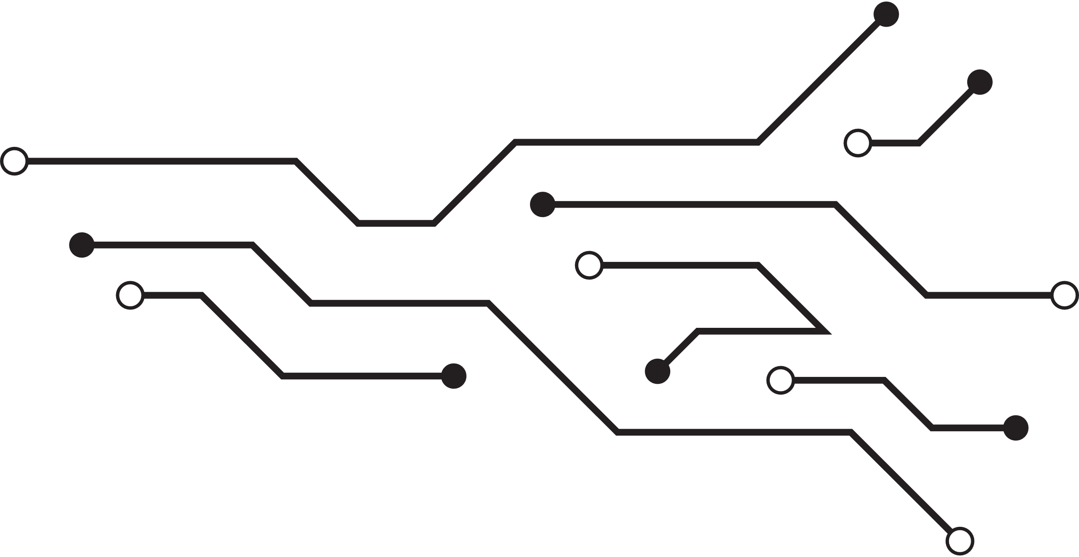
INTRODUCTION
Phase Shift Keying (PSK) is a digital modulation technique that transmits data by varying the phase of a carrier wave.
PSK is widely used in communication systems for its effectiveness in power and bandwidth utilization.
The project focuses on designing, simulating, and implementing a PSK demodulation circuit using Proteus, Simulink, and MATLAB for validation.

Slide 5

Project Objectives
1
Design
2
Simulate
Design a PSK demodulation circuit.
Simulate the circuit using Proteus and MATLAB-Simulink..
3
Implement
4
Analyze
Implement the circuit in hardware.
Analyze the performance.

Slide 6

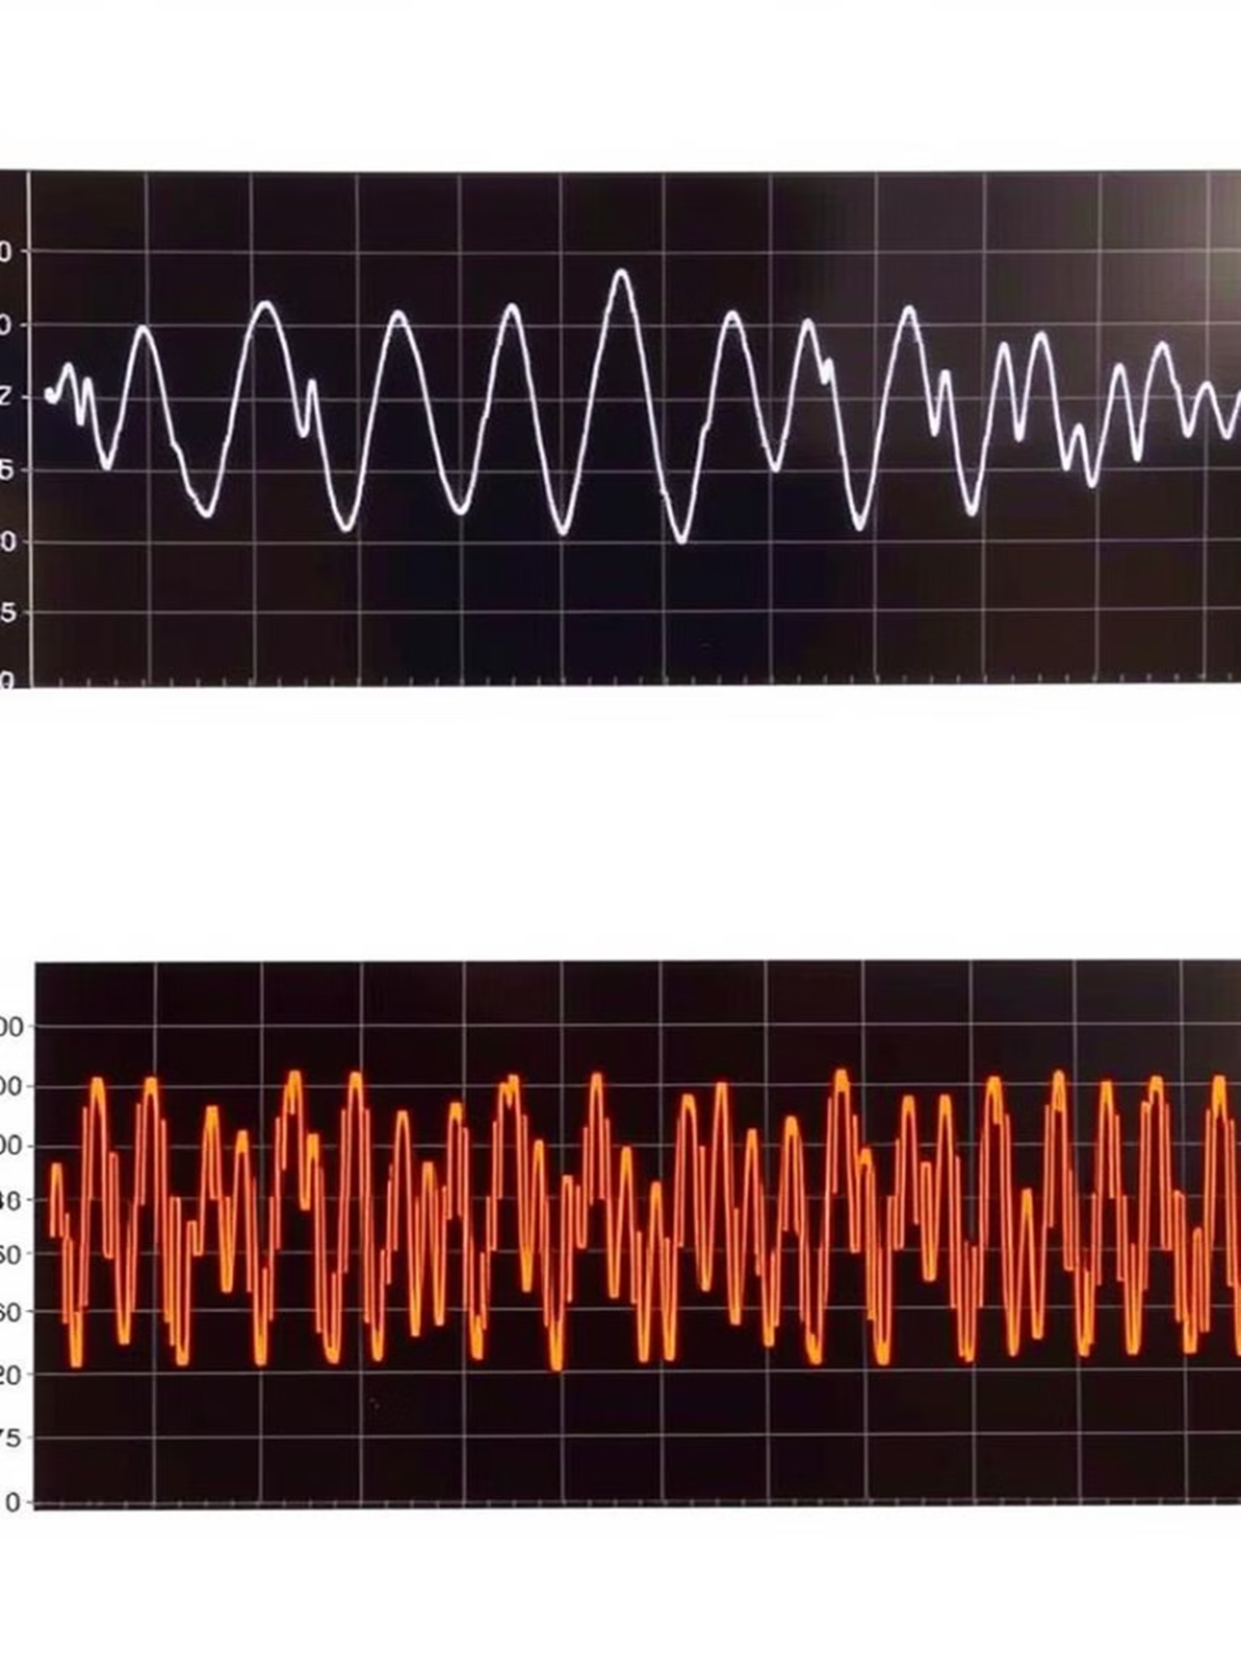




Methodology
Carrier Recovery
Synchronize local carrier signal.
Phase Detection
Mix incoming signal with recovered carrier.
Low-Pass Filtering
Retrieve baseband signal.
Decision Making
Determine transmitted bits.

Slide 7
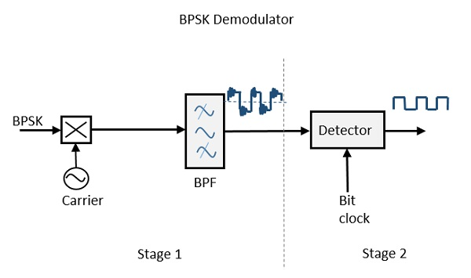
Block Diagram:
LPF
Circuit Diagram:

Slide 8
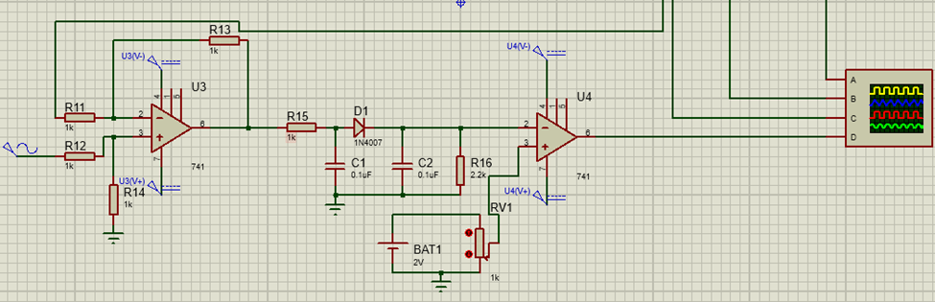
Proteus Simulation
CIRCUIT DIAGRAM​

Slide 9
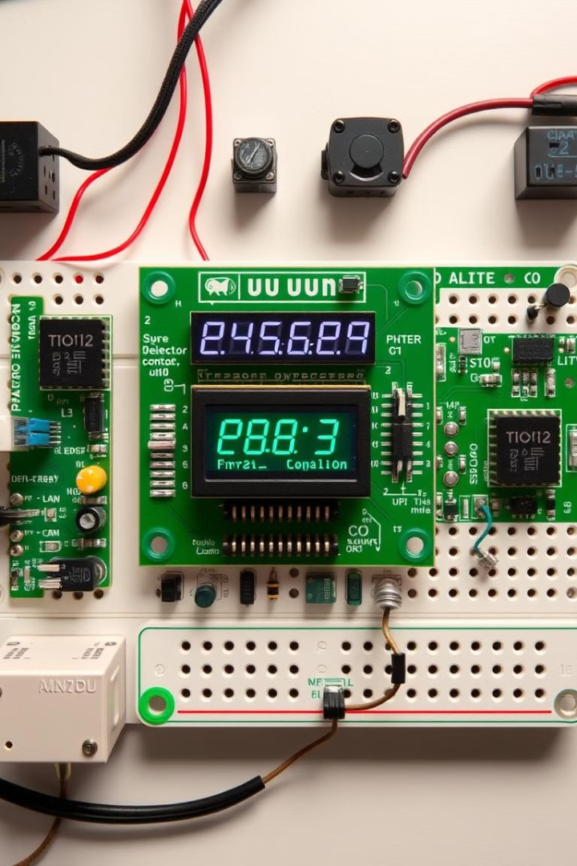




Key Circuit Components
Local Oscillator
Phase Detector
Low-Pass Filter
Generates reference signal.
Compares signal phases.
Filters high frequencies.
Comparator
Converts to digital.

Slide 10
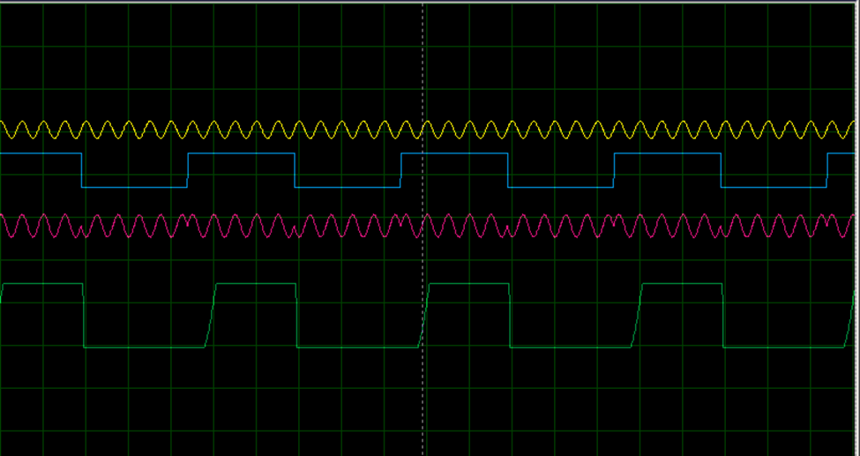
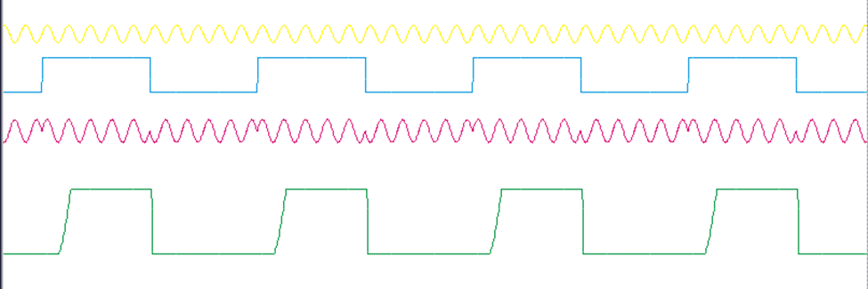
Proteus Output Graph:

Slide 11
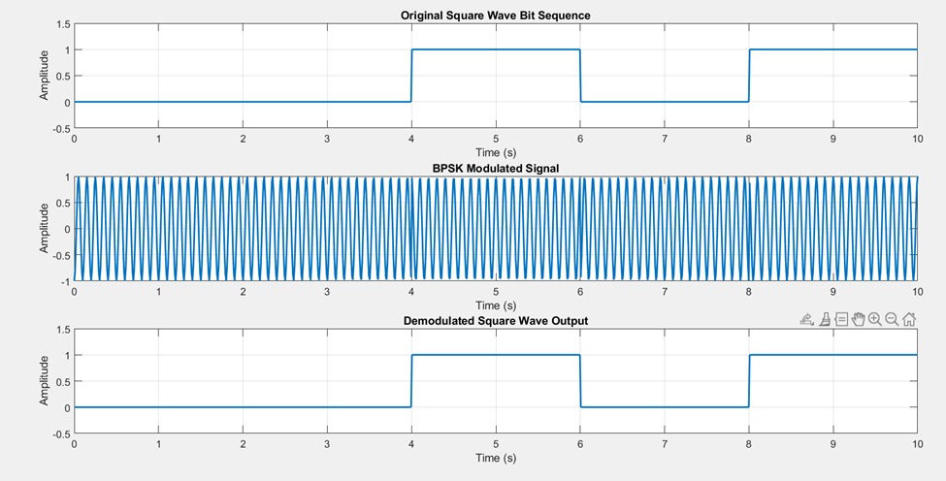
MATLAB Simulation

Slide 12
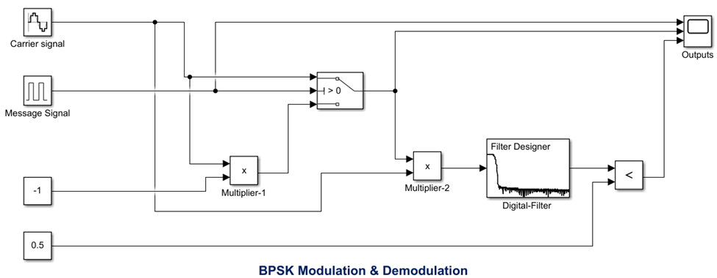
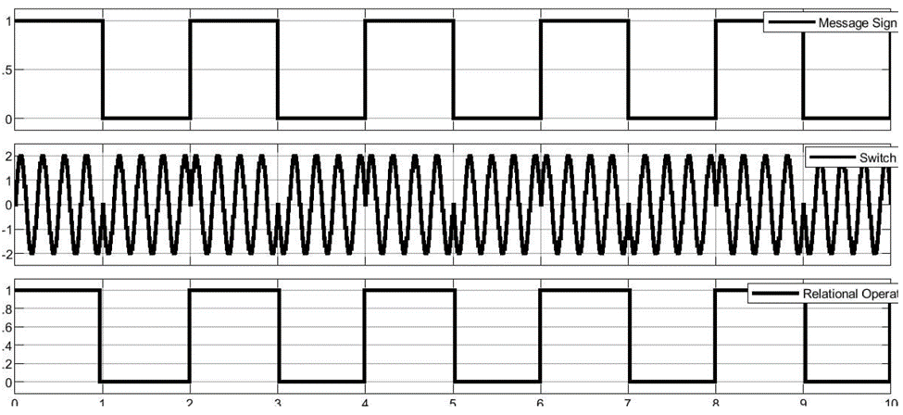
SIMULINK Simulation:
1
BPSK Modulation
Message signal transmitted.
2
Carrier Multiplication
Multiplied by carrier.
3
Filtering
Signal filtered.
4
Recovery
Signal successfully recovered.

Slide 13
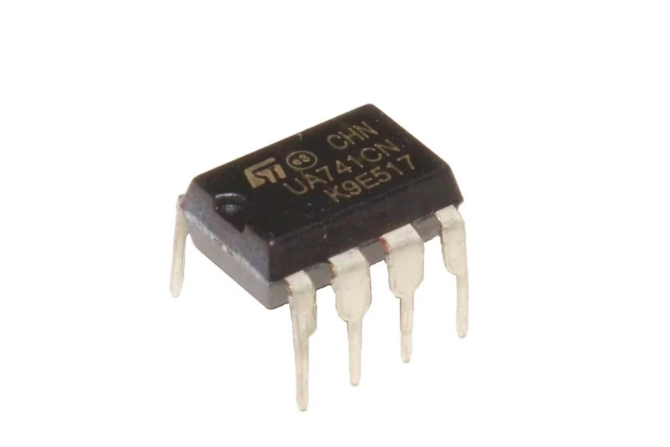
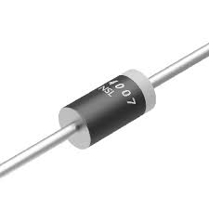
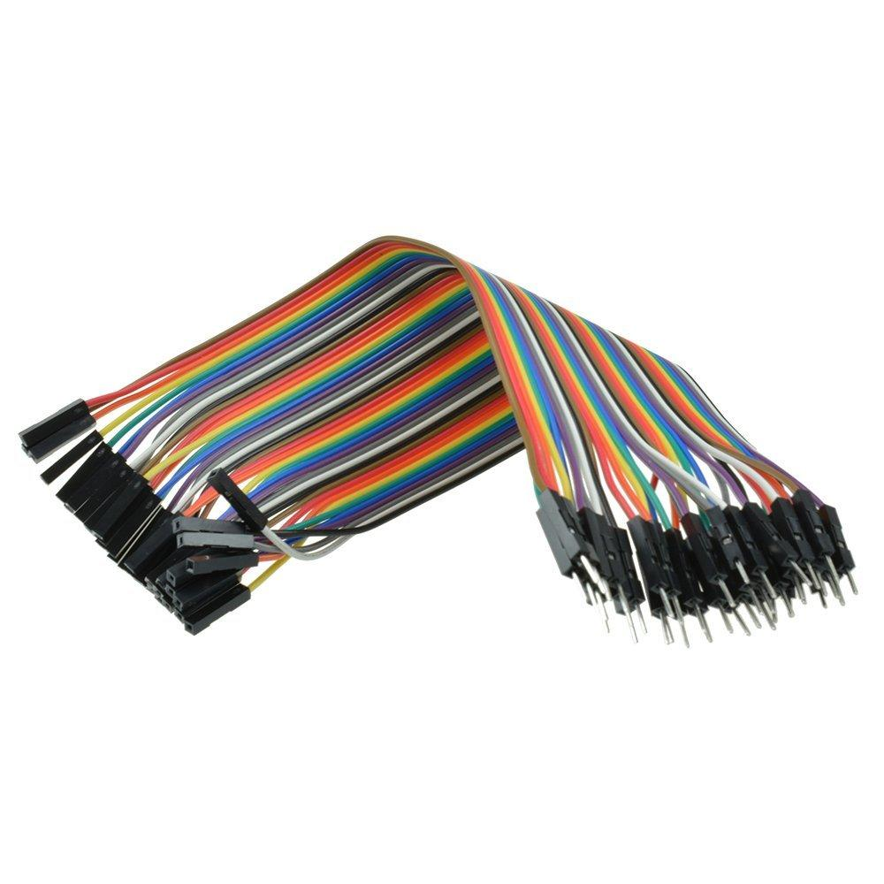
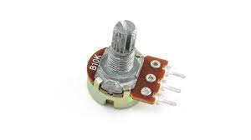
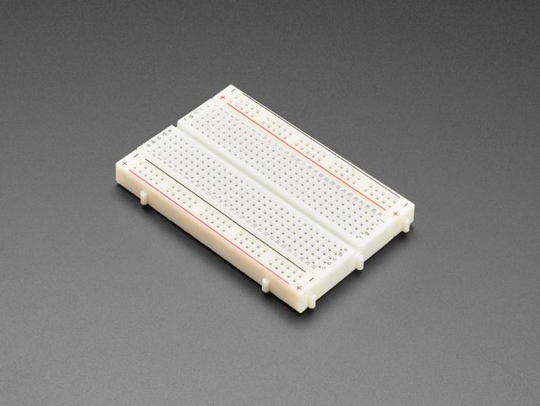
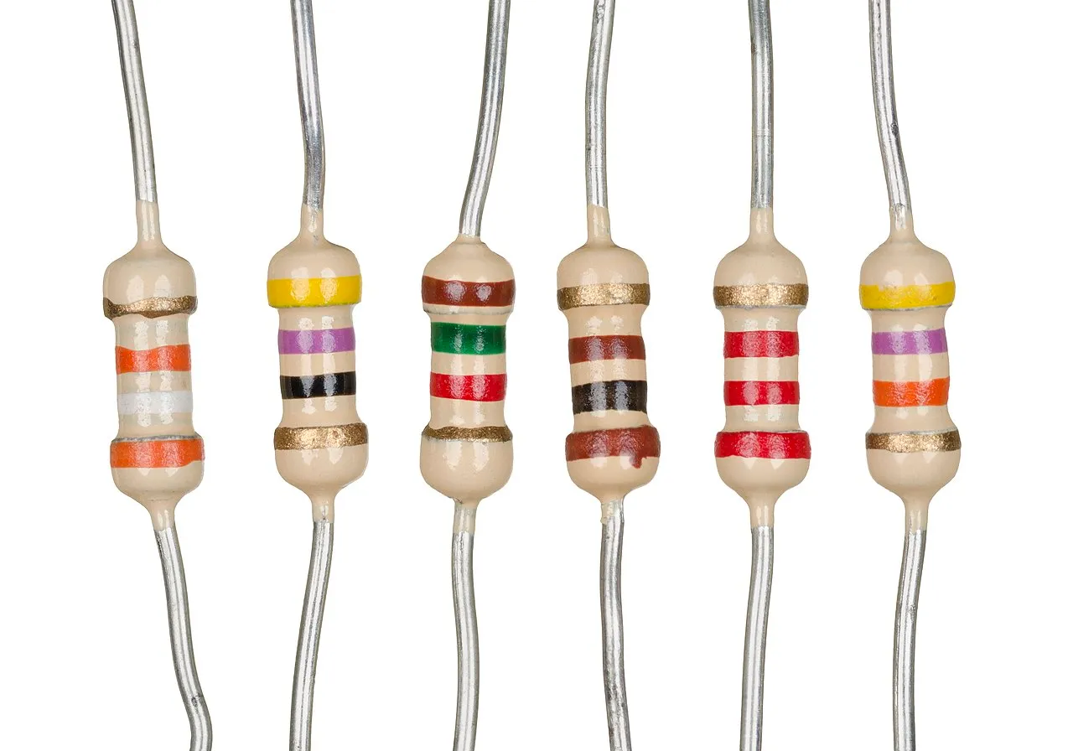
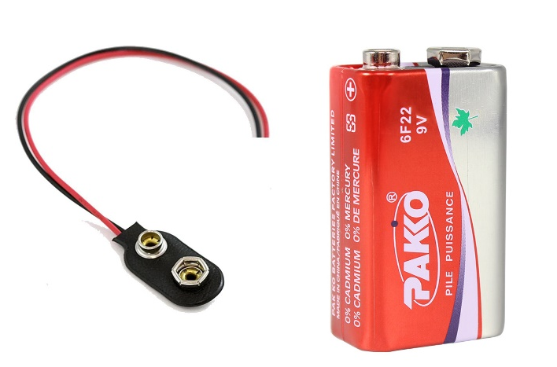
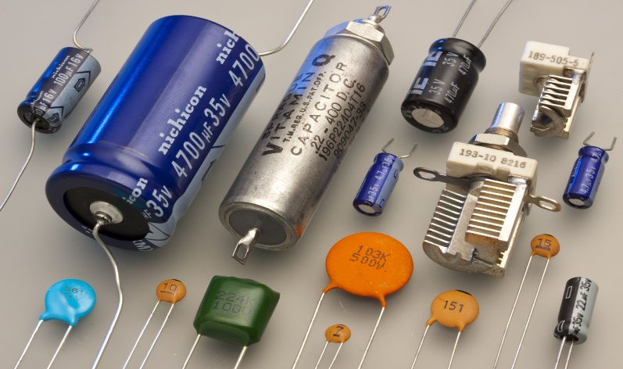
Component List(Physical Demodulation Circuit)
741 OP-AMP DIODE(1N4007)
Resistors Capacitors
(2.2Kohm, 1kohm) ( 0.1uF)
POTTENTIOMETER
Wires
Breadboard
Battery(2V)

Slide 14

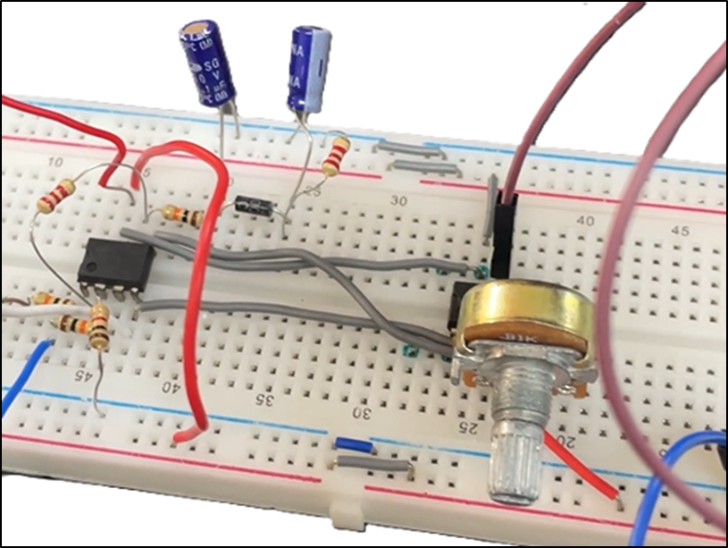
Hardware Implementation
The circuit was implemented on a breadboard .
Local oscillator was realized using a Function
Generator.
Phase detector was implemented using a
OP-Amp.
Output was observed on an oscilloscope .

Slide 15
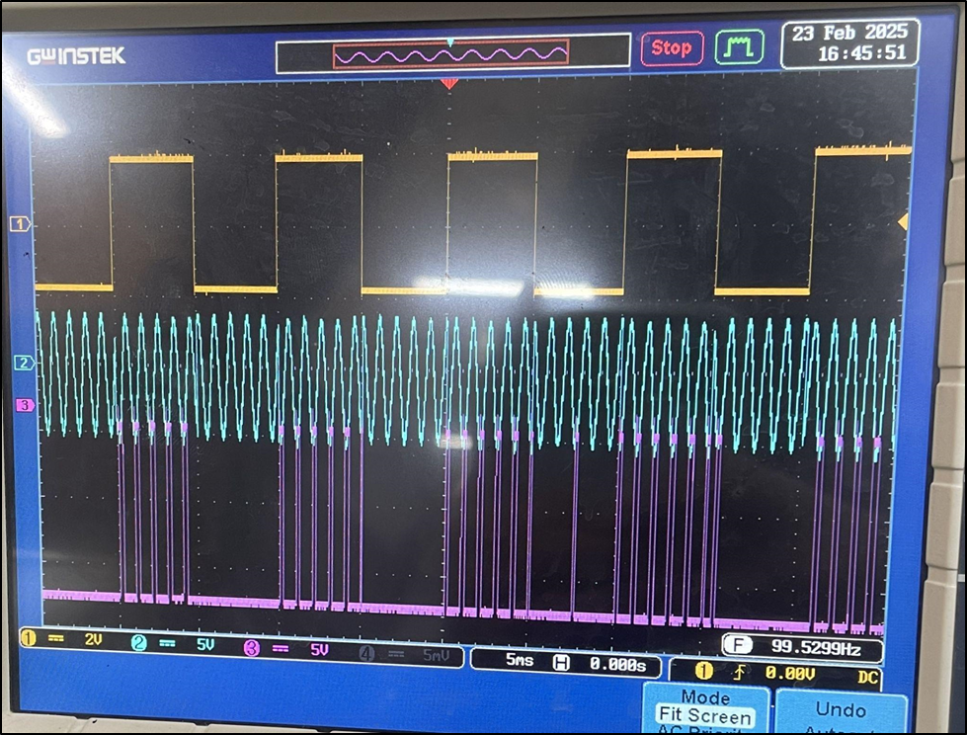
. Results and Analysis
Hardware Results.
The hardware implementation successfully demodulated the PSK signal, with the output matching the expected digital data. The oscilloscope traces showed clear transitions corresponding to the transmitted bits.

Slide 16

Conclusion & Future Work
1
Success
Design, simulation, and hardware were successful.
2
Future
Implement using integrated circuits.
3
Examine
Explore DPSK methods.
4
Assess
Test in a real system.

